Slide 1
Initiative 31: Assessment
Intermediate results of prototyping phase
2024-09-13

Slide 2
Recap: Project Goal
Develop a 4th Eclipse/SWT implementation
… that is …
OS-agnostic
compatible with the existing API
… in order to …
enable improved look & feel
improve customizability
reduce maintenance effort (by finally deprecating/replacing existing implementations)

Slide 3
Recap: Project Phases
Prototypes
Prototypes
Techn. 1
Techn. 2
Techn. 2
Techn. 3
Mature, Maintained SWT Implementations
Techn. 2
Mature, Maintained SWT Implementations
Mature, Maintained SWT Implementations
Mature, Maintained SWT Implementations
MacOS
MacOS
MacOS
MacOS
Windows
Windows
Windows
Windows
Mature, Maintained SWT Implementations
Linux
Linux
Linux
Linux
Techn. 2
Current
Prototype
Realization
Production
Replacement

Slide 4
Prototype Phase: Evaluation
Outcome: Assessment of technologies with respect to key questions:
Is technology X suited for the project’s goal?
Which of the suited technologies best fits for the project’s goal?
Used by WG companies to choose best fitting one to realize
Remarks:
We (prototype developers) will not make the decision but provide the necessary information to make an educated decision
There will not be a “winner technology”, it is all about an objective evaluation for the goals defined in the beginning

Slide 5
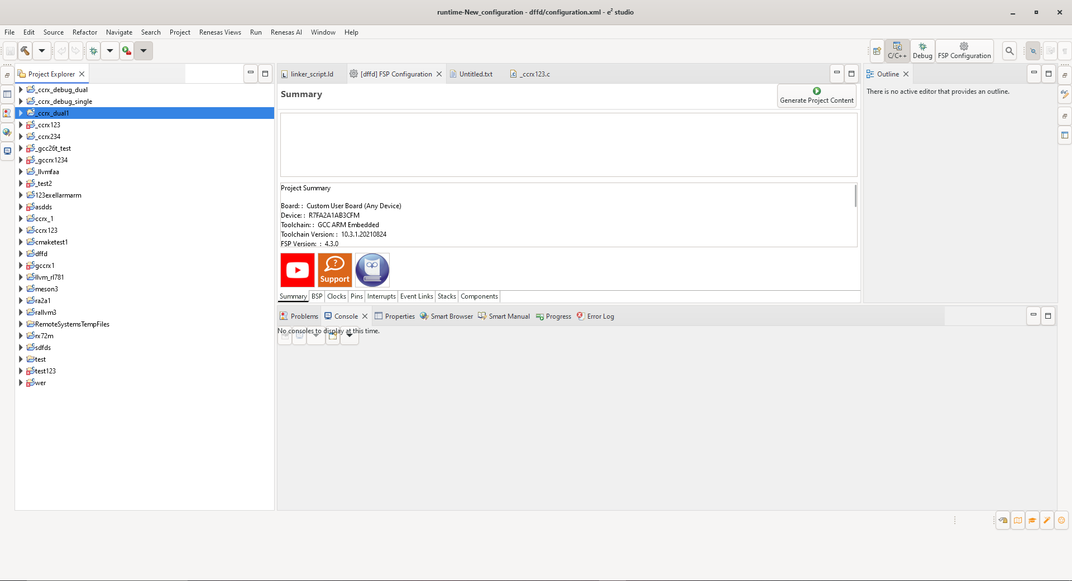
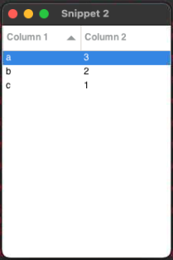
Achievements: GTK
Eclipse applications generally running with GTK3 on Windows
Eclipse applications start but rather broken with GTK4 on Windows
First SWT snippets running with GTK4 on MacOS

Slide 6
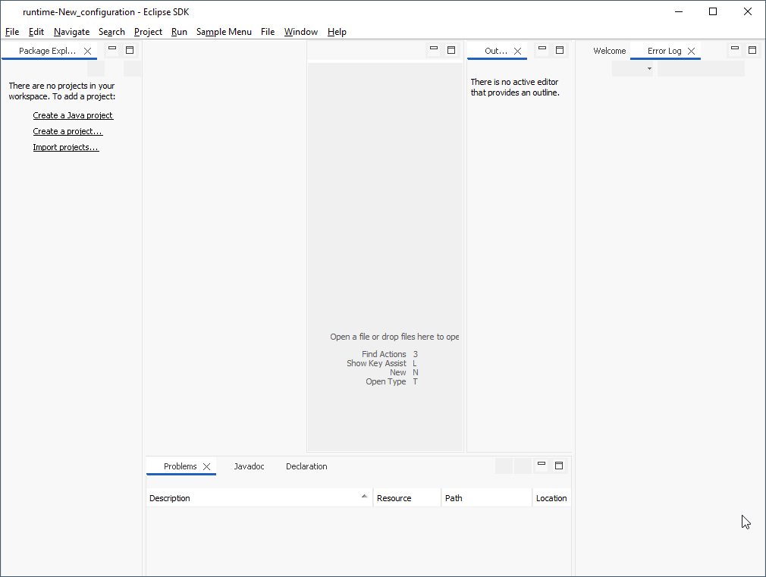
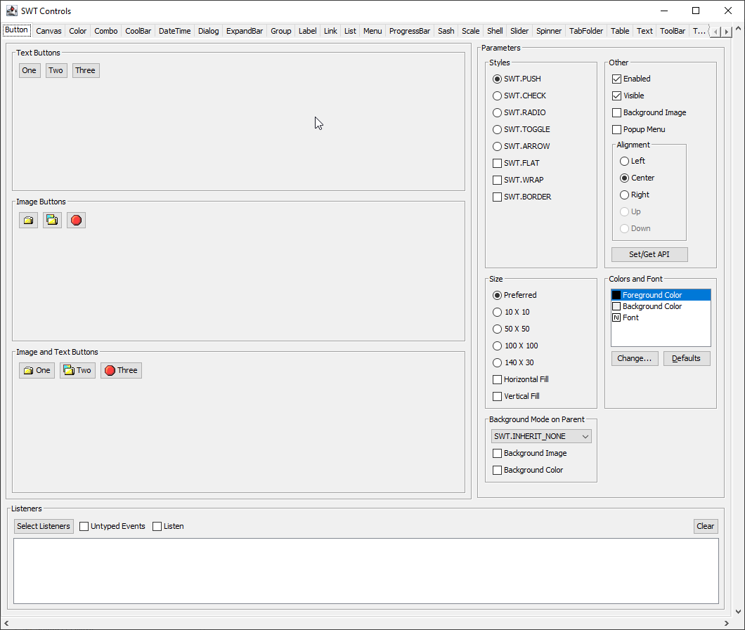
Achievements: Swing
SWT ControlExample works (containing all widgets)
Eclipse applications start, but are still rather broken
Themeing works

Slide 7
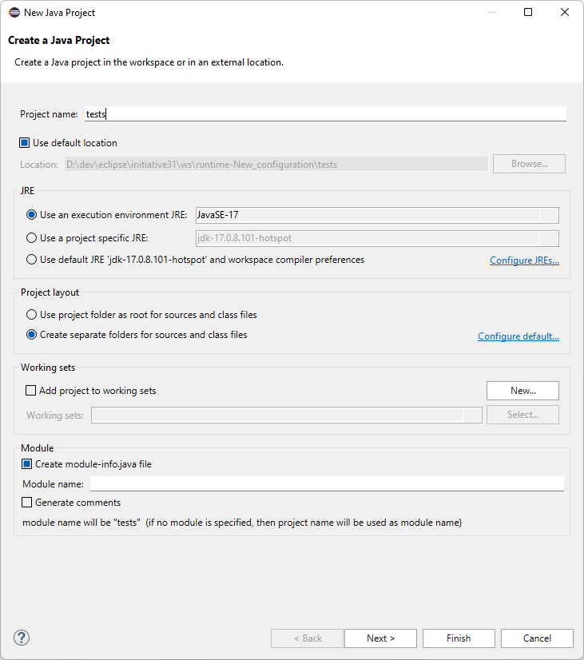
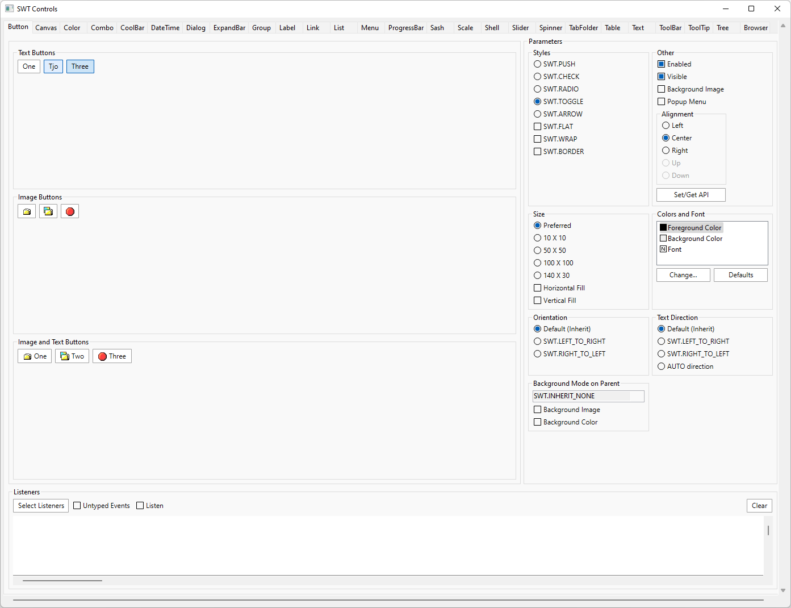
Achievements: Custom-Drawn Widgets
Several widgets custom implemented (Botton, Text, Label)
SWT ControlExample and Eclipse applications work
Custom-drawn widgets can selectively be rendered with other graphics engine (Skia)

Slide 8
General Assessment
Overall Insights
Solutions requiring low specific knowledge (e.g., only Java skills) should be preferred
Separating graphics engine and widget implementation should be preferred to make them independently exchangeable
Efforts for a completely new implementation (complete implementation of all SWT functionality) hardly predictable
All options should be performance-analyzed with existing SWT performance tests

Slide 9
Assessment Overview
Technology | Assessment | Major Criteria
VCL/LibO (Skia) | unsuited | - Similar issues to SWT → does not address essential problems - High complexity and efforts
GTK | potentially suited (further prototyping) | + SWT implementation exists - Inconsistent implementation of SWT API (compared to Win32/Cocoa) - Printing support, maintenance of ports unclear - Native integration may be messy (e.g., native browser) - Performance unclear (initial results indicate degradation compared to win32)
Swing | potentially suited (further prototyping) | + Existing prototype looks promising + Fitting skillset: purely Java - Native window integration / browser integration unclear - Maintenance mode (no progress, required extensions may be impossible)
Custom-Drawn (Skia) | likely suited (further prototyping) | + High flexibility, full control over functionality and changes + Separation of widgets and graphics engine (exchangeability) + Fitting skillset: purely Java - Unclear efforts for initial implementation

Slide 10
Technology Candidate: GTK
Assessment: Potentially Suited
+ Implementation exists
- Inconsistent SWT API implementation: clients have to provide custom code to avoid deadlocks when making OS calls from within OS callback → necessary adaptation of, e.g., Windows-only RCP products?
- Native integration (e.g., browser) unclear, might be messy; maintenance of ports unclear
- Performance might be problematic (initial results show degradation on win32)
Further Prototyping Necessary
Identify whether performance is a blocker
Investigate whether necessary client updates are too much effort / risk
Investigate native window / browser integration

Slide 11
Technology Candidate: Swing
Assessment: Potentially Suited
+ Existing prototype looks promising
+ Fitting skillset: purely Java
- Native window integration / browser integration unclear
- Maintenance mode (no progress, required extensions may be impossible)
Further Prototyping Necessary:
Integration of native windows / browser etc.
Investigation of font rendering quality
Impact of being in “maintenance mode” → making extensions/enhancements to fully implement SWT may be impossible?

Slide 12
Technology Candidate: Custom-Drawn
Assessment: Likely Suited
+ High flexibility, full control over functionality and changes
+ Separation of widgets and graphics engine (exchangeability, also target of IntelliJ (Humble UI))
+ Fitting skillset: purely Java
- Unclear efforts for initial implementation
o Window management remains OS-dependent → no complete OS independence but allows to still integrate native printing, native windows, browser, …
Further Prototyping Necessary
Fully implement one representative widget to estimate efforts (e.g., Tree)

Slide 13
Technology Candidate: LibO/VCL (Skia)
Assessment: Unsuited
- Limited configurability (comparable to SWT)
- Complexity: C++ code (debugging, knowledge)
- Complexity: integration (inter-process communication, JNI/FFM, …)
- Complexity: UNO API (hard to use, limited documentation)
- Effort: Extraction and maintenance of standalone VCL
- Governance: unclear whether independent usage / reusable implementation of VCL is accepted/supported by LibreOffice developers

Slide 14
Target Technology Stack: External Library
App
Eclipse Applications, JFace, …
SWT
Serves as adapter to framework/library
SWT API
OS-Agnostic SWT Graphics/Widgets
SWT Win Fragment
SWT Mac Fragment
SWT Linux Fragment
Contains widgets with graphics engine, e.g., GTK, Swing
Lib
OS-Agnostic Widgets Framework/Library
OS
Win32 (OLE/COM/…)
MacOS Cocoa (Foundation/…)
POSIX (Glib/DBUS/IO/…)

Slide 15
Target Technology Stack: Custom-Drawn
App
Eclipse Applications, JFace, …
Contains widget implementations against graphics library API
SWT
SWT API
OS-Agnostic SWT Graphics/Widgets
SWT Win Fragment
SWT Mac Fragment
SWT Linux Fragment
Lib
OS-Agnostic Graphics Framework/Library
Exchangeable graphics library, e.g., Skia
OS
Win32 (OLE/COM/…)
MacOS Cocoa (Foundation/…)
POSIX (Glib/DBUS/IO/…)

Slide 16
Partial / Incremental Custom Drawing
Window (native)
Text (native)
Button (custom)
Custom widget can either directly draw onto native GC or onto other GC and copy result over
Shown to user
drawn into
adapts
adapts
optionally uses
Win32
Skia
Window
Widgets
GC
GC
wraps and copies to
render into
While some widgets (and the window) are still native, rendering into a custom GC (like Skia) requires a copy of the rendering result to an OS GC that renders into the native window.

Slide 17



Thank you for the work done so far!

